Slide 1
Final Year Project Presentation
“ HYBRID SOCIAL NETWORK FEED GENERATION ALGORITHM ”
Carried out by:
Under the guidance of:
Mrs. Sushila Shidnal
Assistant Professor
Department of Computer Science
1MV14CS009 | : | Akhil S
1MV14CS033 | : | Devipriya Sarkar
1MV14CS074 | : | Praveen Kumar G
1MV14CS085 | : | Ravikiran R

Slide 2
Introduction
FEED
The term “Feed” (or news-feed in case of social networks like Facebook) is a data representation format used for providing users or subscribers with frequently updated content
HOW TO CHOOSE A FEED GENERATION ALGORITHM
Several questions need to be answered to decide the feed generation technique required such as:
Are there more producers than consumers?
What is the maximum acceptable latency?
Will the feed items be sorted in the chronological order or ranked selectively?
Will the feed be infinitely long or of fixed length?

Slide 3
Abstract
Existing user feed fetching and feed maintenance processes have been utilising Hybrid Push-Pull Data Distribution Models to handle user events. These distribution models have been characterised to have significantly high architectural complexity.
In this project we propose a Hybrid Feed Distribution Schema to handle this problem elegantly We implement our model into a social network platform which we would deploy ourselves and demonstrate the proposed enhancement in feed data distribution between its users.

Slide 4
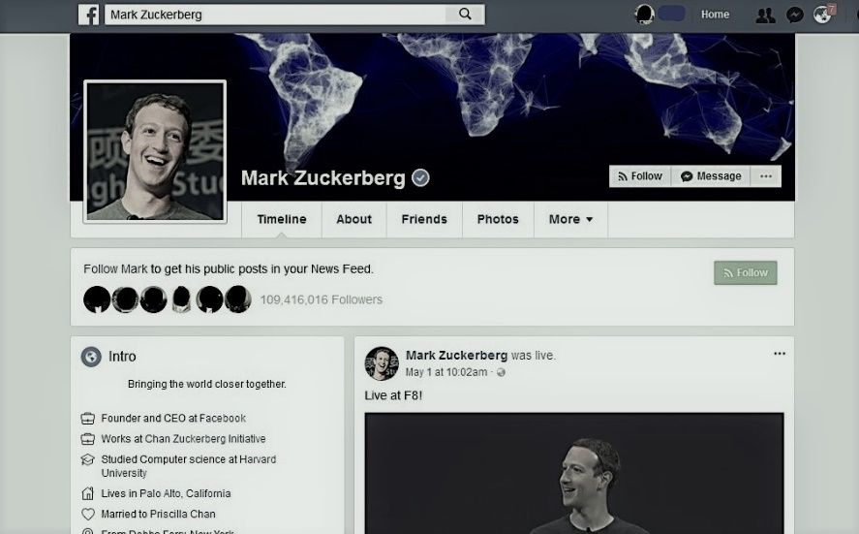
Literature Review
An activity stream is a list of recent activities performed by an individual, typically on a single website. Activities in a stream include publishing a post, commenting on a post and ‘liking’.

Slide 5
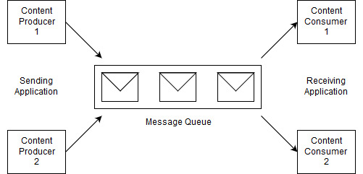
Literature Review ( Cont. )
In applications requiring a feed, each item in the activity streams generated by users need to be processed. This can be done by pushing items to a message queue while another component performs actions on these such as ranking and pushing them to other users.

Slide 6
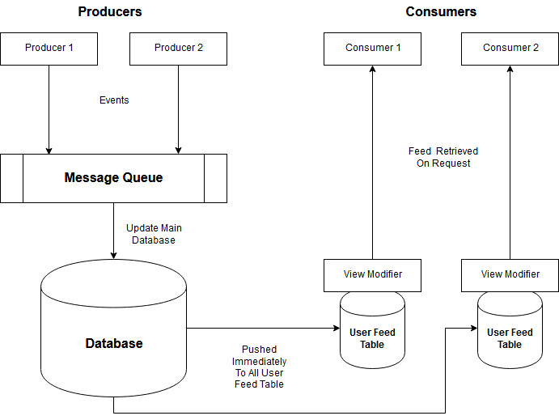
Literature Review ( Cont. )
Push Model / Fan-out-on-write
Each activity is pushed to a generated feed maintained for every consumer.

Slide 7
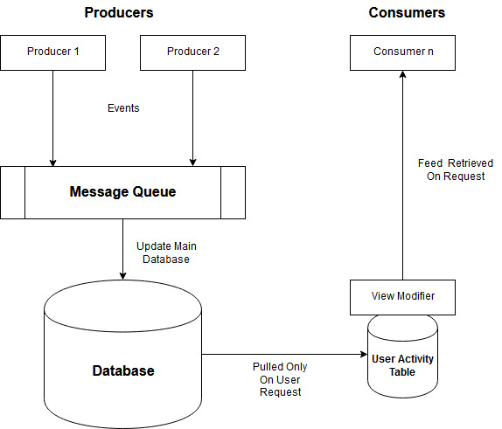
Literature Review ( Cont. )
Pull Model / Fan-out-on-load
Activities are retrieved from producers when user logs in or refreshes the feed.

Slide 8
Objective
To develop a hybrid user specific feed fetch model to improve the performance and scalability in social applications.
Develop a social networking platform application to share academic resources among students and teachers (Called as QuickNotes).
Implement the hybrid feed fetch model into this social platform to demonstrate performance enhancement.

Slide 9
Scope
The Following are the scope of this project :
Defining the feed generation problem formally as a partial view materialization problem.
An analysis of the optimization problem that determines the events that needs to be pushed and the events that needs to be pulled.
Algorithms for selectively pushing/pulling events to a consumer feed through decisions made locally and establishing the global performance benefit that it provides.
To implement our techniques in a social networking platform to show that it performs well in practice.

Slide 10
Scope ( Cont. )
The Following are not the scope of this project :
Aggregation of events in the consumer feed.
Revoking of events later from the feed.
Changing position of the events in the consumer feed to avoid duplication (in case where multiple producers produce the same event).
Diversity of the events in the feed.

Slide 11
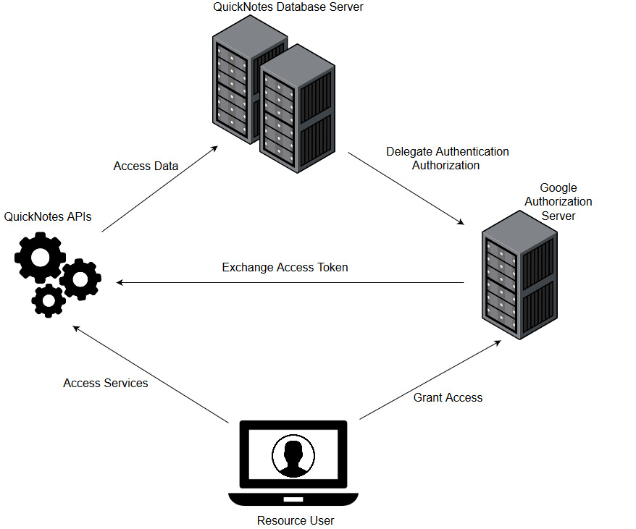
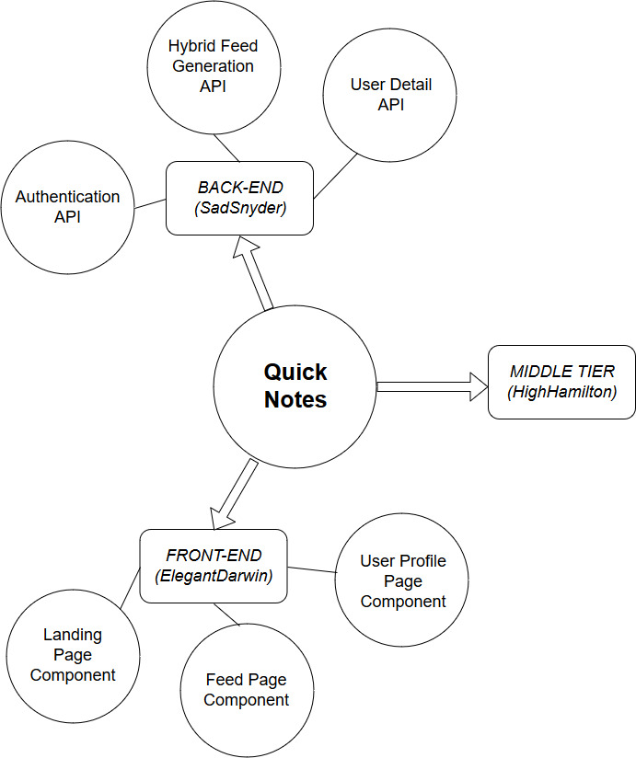
System Design & Analysis
Overview of The Platform
Modules of Quicknotes

Slide 12
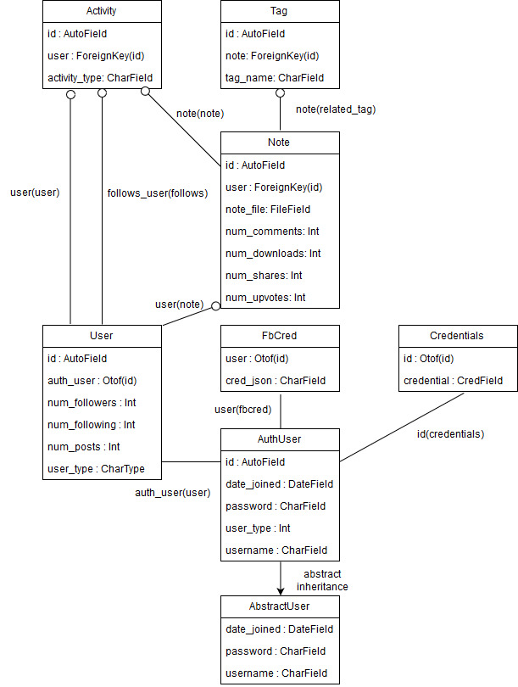
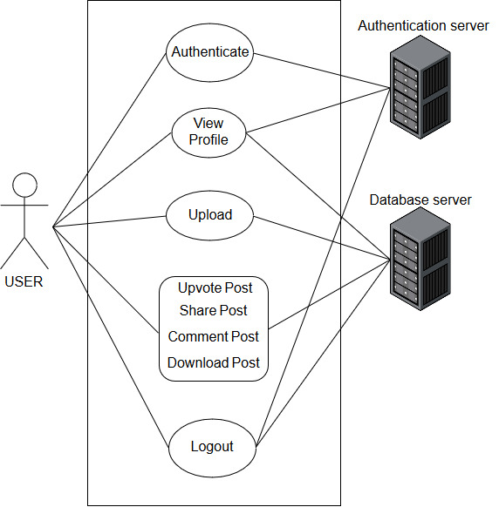
System Design & Analysis ( Cont. )
Use-Case Diagram
Database Schema

Slide 13
Implementation
Push Model Algorithm
Algorithm for Push
Input: e (Event), User Output: User Feed
1: | onEvent(e, User):
2: | for each follower of User:
3: | follower.Feed.push(e)
4:
5: | fetchFeed(User):
6: | return User.Feed

Slide 14
Implementation ( Cont. )
Pull Model Algorithm
Algorithm for Pull
Input: e (Event), User Output: Feed
1: | onEvent(e, User):
2: | User.activity.push(e)
3:
4: | fetchFeed(User):
5: | Feed = []
6: | for each following of User:
7: | Feed.append(following.activity.top)
8: | return Feed

Slide 15
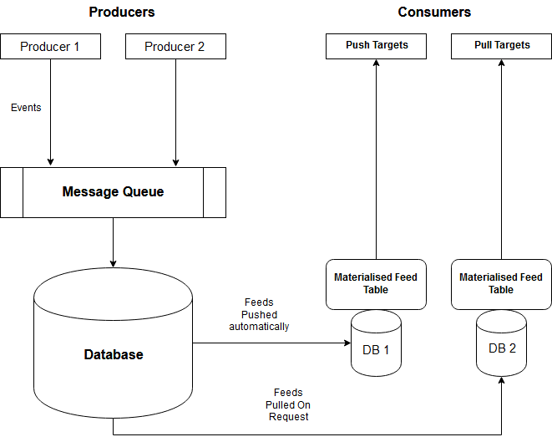
Implementation ( Cont. )
Our Hybrid Model Implementation

Slide 16
Implementation ( Cont. )
Our Hybrid Model Algorithm
Hybrid algorithm for feed generation
Input: e (Event), User Output: User Feed
1: | on Event(e, User):
2: | for each PUSH follower of User
3: | follower.feed.push(e)
4:
5: | fetchFeed(User):
6: | if User is PUSH:
7: | return User.Feed
8: | else if User is PULL
9: | User.Feed = []
10: | for each following of User:
11: | User.Feed.append(following.activity.top)
12: | return User.Feed

Slide 17
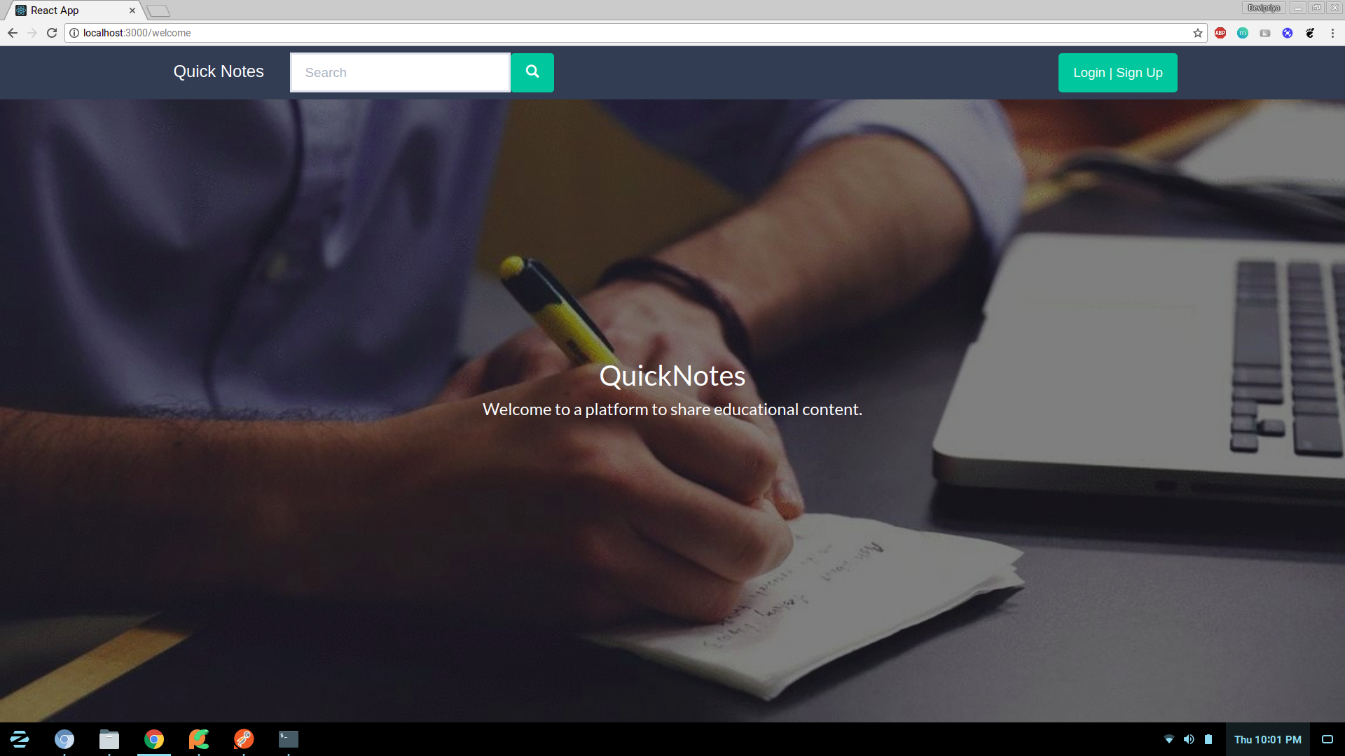
QuickNotes Platform in Action
Landing Page

Slide 18
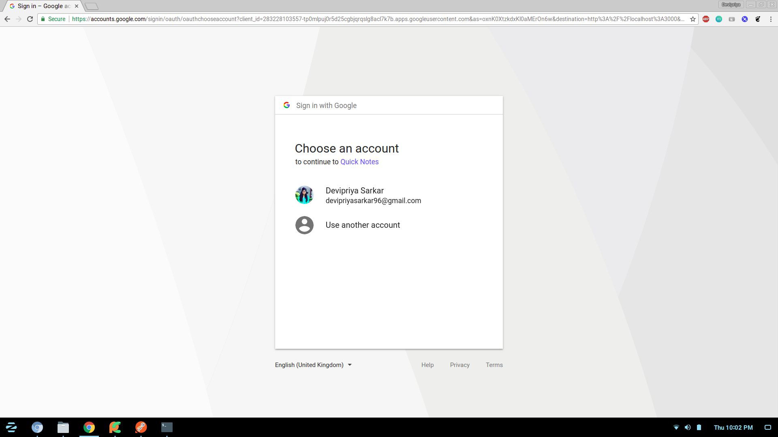
QuickNotes Platform in Action ( Cont. )
Google Authentication

Slide 19
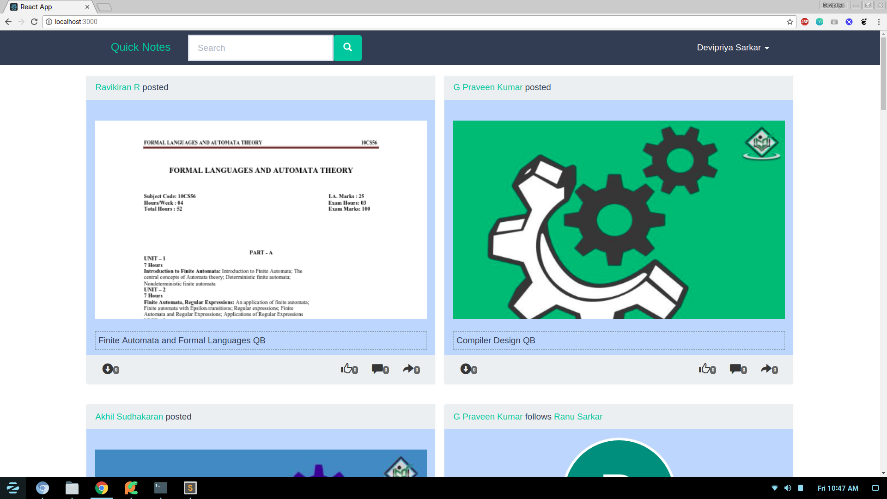
QuickNotes Platform in Action ( Cont. )
News Feed

Slide 20
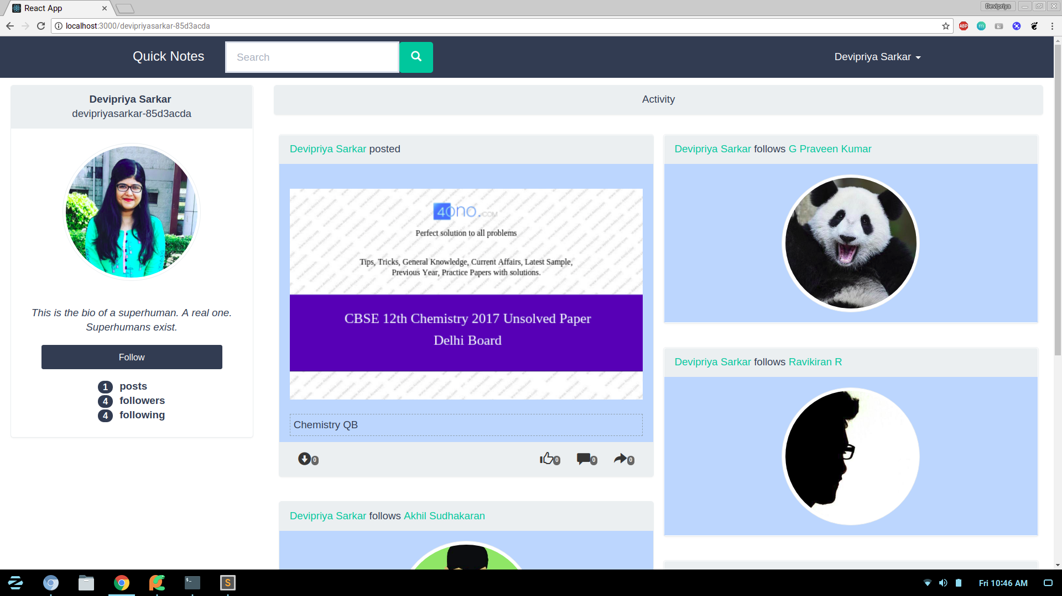
QuickNotes Platform in Action ( Cont. )
Profile Page

Slide 21
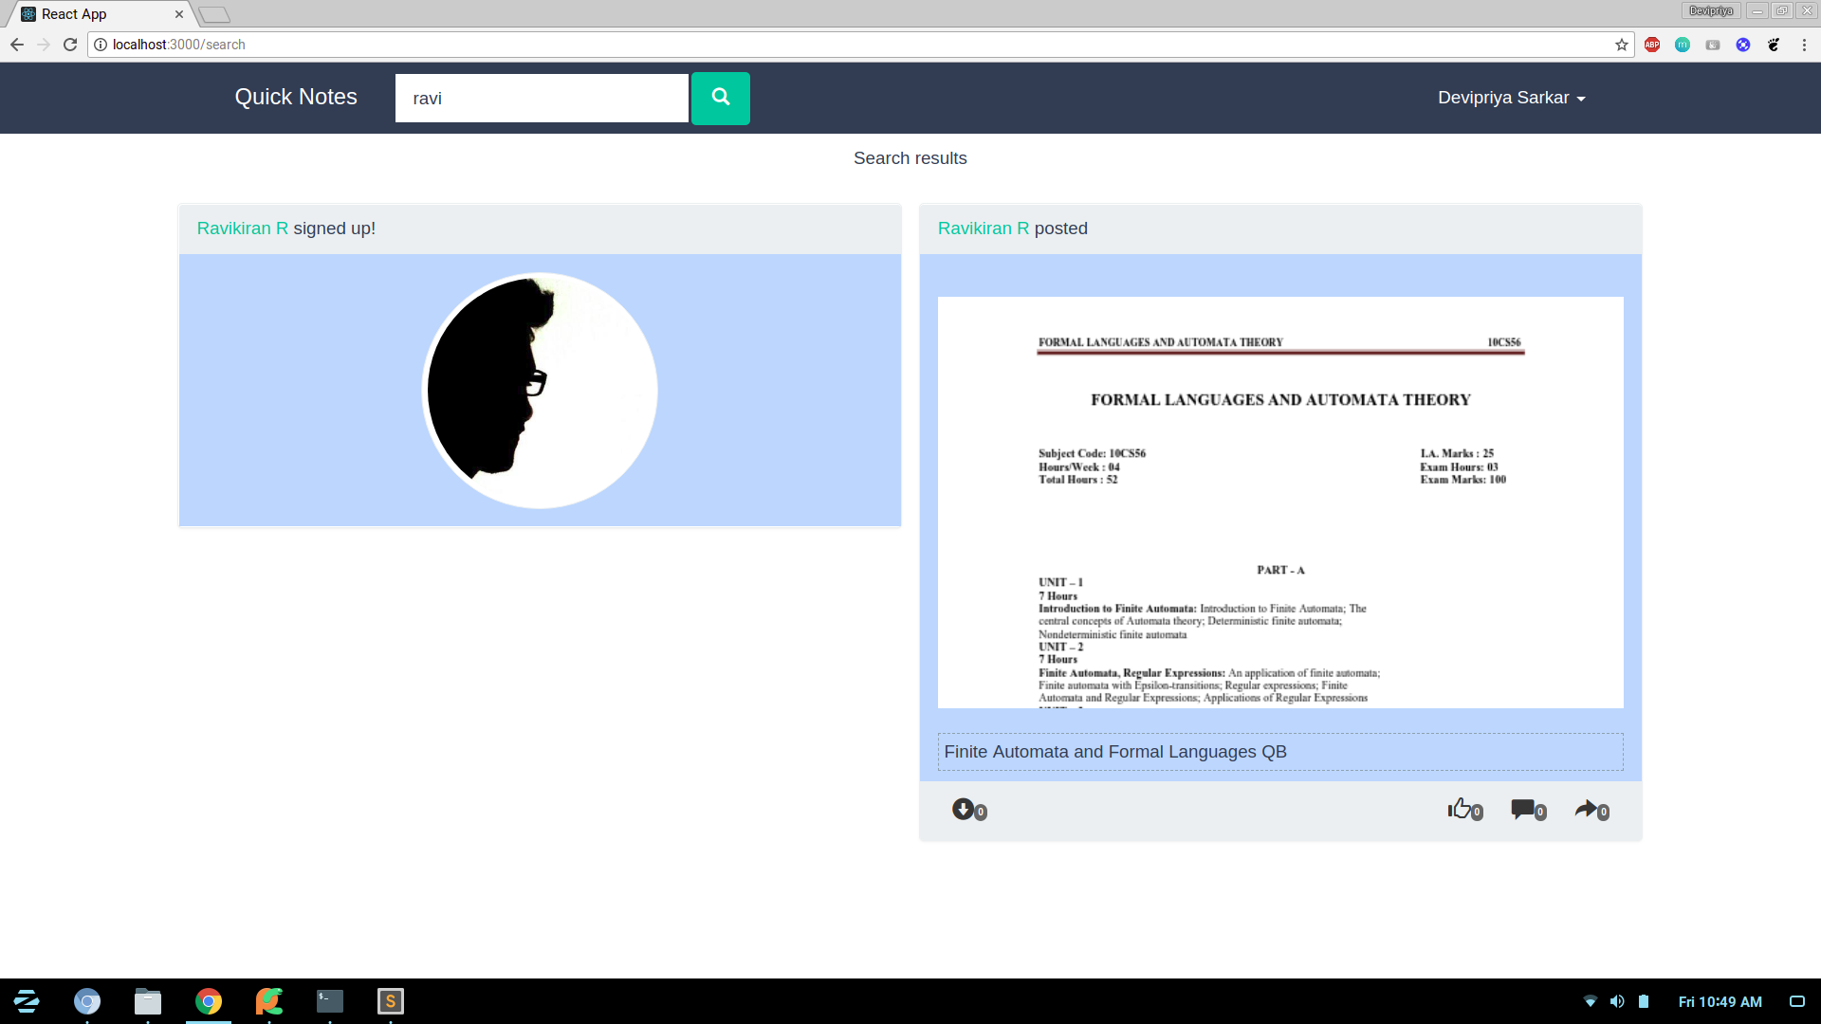
QuickNotes Platform in Action ( Cont. )
Search Bar

Slide 22
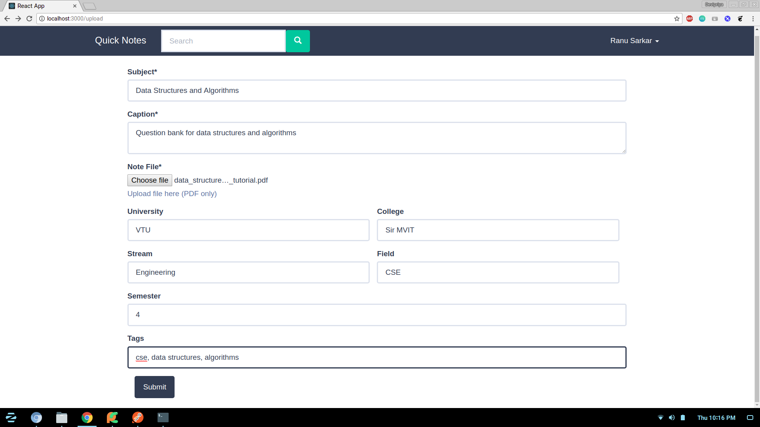
QuickNotes Platform in Action ( Cont. )
Upload Form

Slide 23
References
A. Silberstein et al. “Feeding Frenzy: Selectively Materializing Users’ Event Feeds” SIGMOD, June 6–11, 2010.
V. Sharma et al. “Scaling Deep Social Feeds at Pinterest” SocialCom, 2013.
J. Dean. “Designs, lessons and advice from building large distributed systems” 3rd ACM SIGOPS International Workshop on Large Scale Distributed Systems and Middleware 2009.
https://en.wikipedia.org/wiki/Activity_stream
https://aws.amazon.com/message-queue/
https://code.facebook.com/posts/781984911887151/serving-facebook-multifeed-efficiency-performance-gains-through-redesign/
https://blogs.vmware.com/vfabric/2013/04/how-instagram-feeds-work-celery-and-rabbitmq.html
https://engineering.instagram.com/what-powers-instagram-hundreds-of-instances-dozens-of-technologies-adf2e22da2ad
https://blog.twitter.com/engineering/en_us/topics/infrastructure/2017/the-infrastructure-behind-twitter-scale.html
http://highscalability.com/blog/2013/10/28/design-decisions-for-scaling-your-high-traffic-feeds.html
http://highscalability.com/blog/2013/7/8/the-architecture-twitter-uses-to-deal-with-150m-active-users.html
https://www.quora.com/What-are-the-best-practices-for-building-something-like-a-news-feed
https://fanout.io/docs/smartfeeds.html
https://www.slideshare.net/danmckinley/etsy-activity-feeds-architecture
https://stream-framework.readthedocs.io/en/latest/

Slide 24
THE END

